Slide 1
Power Management in Smart Homes Energy Usage Analysis and Forecasting
IOT Analytics

Slide 2
analysis of the power consumption dataset
Data visualization of the meaningful time periods highlighting patterns of power usage
Seasonal and non-seasonal forecasting with three different time series regression models
Recommendations for Energea

Slide 3
PERIODS OF TIME TO VISUALIZE: DAY, WEEK, YEAR
Daily power consumption: January 9th in 2007, 2008 and 2009
Weekly routine: regular behaviors during the course of a week (2nd week of March)
Year: illustrating seasonal patterns (years: 2007, 2008 and 2008)

Slide 4
DAILY POWER CONSUMPTION: JANUARY 9TH 2007, 2008, 2009
Similar daily pattern of energy usage within all the years:
Kitchen appliances are usually used around dinner time
Sub-meter measuring water heater and AC usage presents strong regularity
Peak in the laundry room in 2007 (Tuesday) represents a laundry day
In 2007 and 2008 Tuesday was often - but not the only - laundry day and this pattern was slightly changed in 2009 (most of the laundry was done on Wednesdays and weekends)

Slide 5
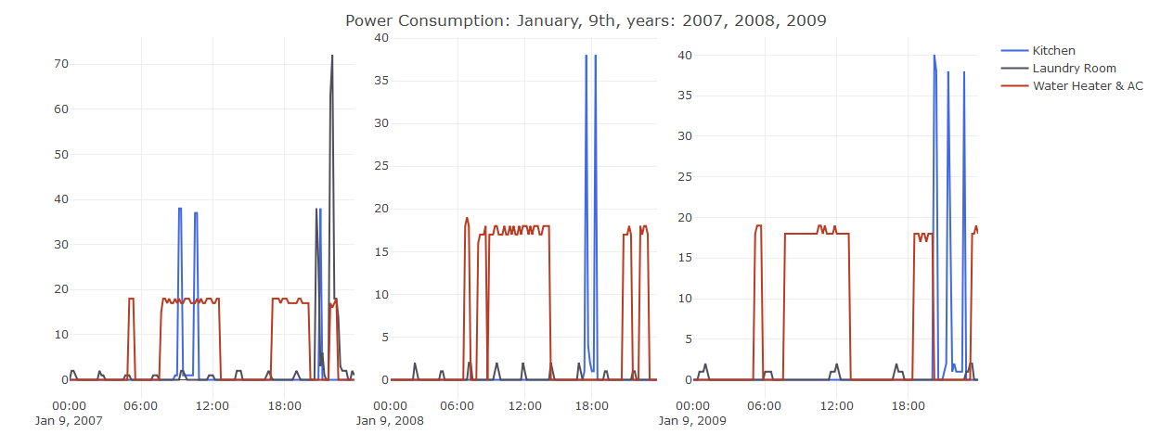

Slide 6
WEEKLY POWER CONSUMPTION: 2nd WEEK OF MARCH 2007, 2008, 2009
Patterns are quite regular, there are no unexpected changes within any sub-metering device
Noticeable peak in years 2007 and 2008 is related to more intense usage of appliances in the laundry room

Slide 7
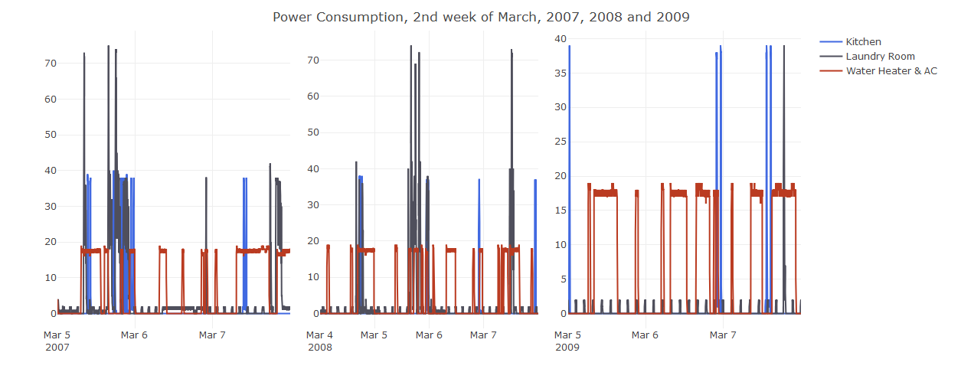

Slide 8
ANNUAL POWER CONSUMPTION: 2007, 2008, 2009
Significant (10 watt-hours) increase in power usage related to sub-meter # 3 (AC and water heater) in years 2007 and 2008, compering to 2006
Lack of information about local climate is an important drawback
Increase in sub-meter # 3 is related to summer as well as winter months (example: Power consumption 2009) which may be caused by AC usage during summer and heating in cold months
Lack of information regarding proportion of AC power usage vs water heater is an important shortcoming
There is no strong pattern related to a day of laundry however some mentioned earlier generalizations are possible within an annual context

Slide 9
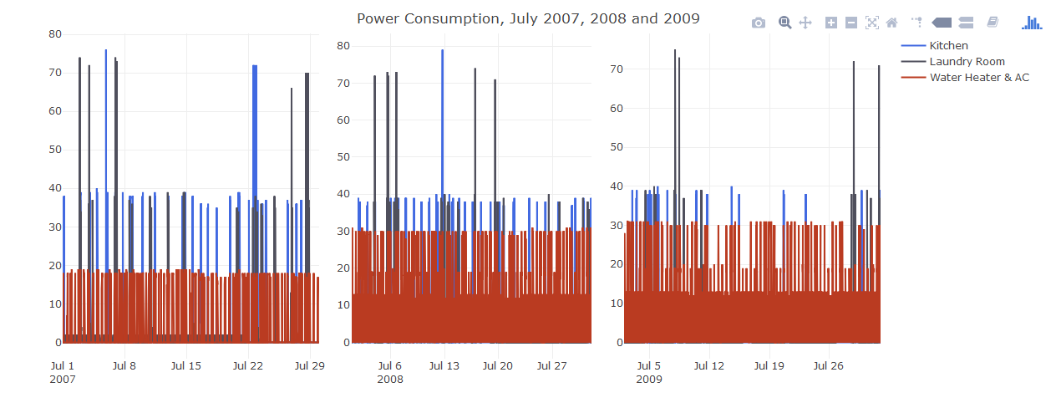

Slide 10
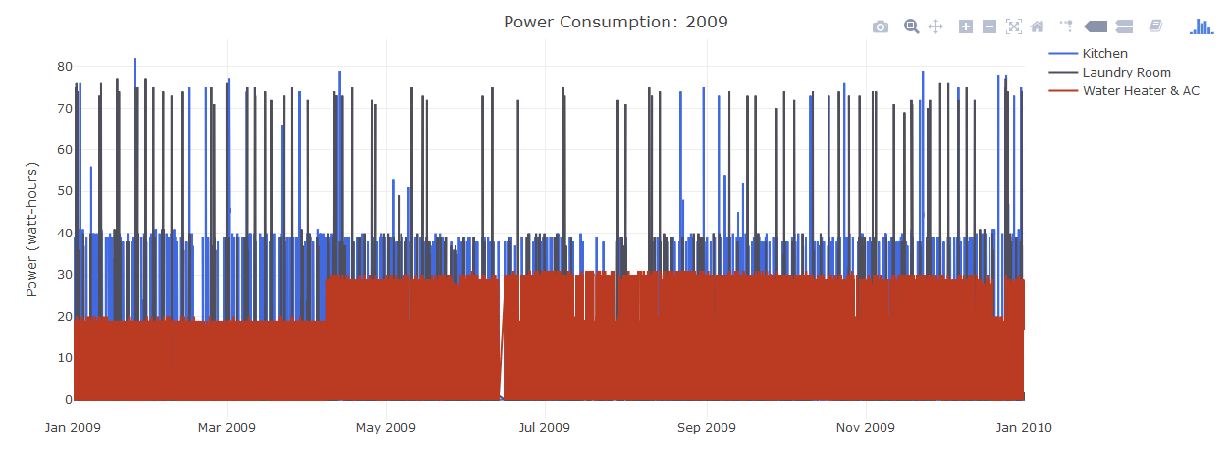

Slide 11
SUBMETERS # 1, 2, 3 DAILY OBSERVATIONS IN YEARS 2006, 2007, 2008
Sub-meters # 1 (Kitchen) and #2 (Laundry Room) have a bigger variety, compering to the sub-meter # 3 (Water Heater and AC)
For this reason any predictions regarding sub-meters # 1 and 2 are more uncertain
Sub-meter # 3 is characterized by more predictable cycles

Slide 12
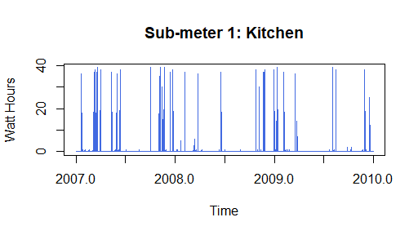
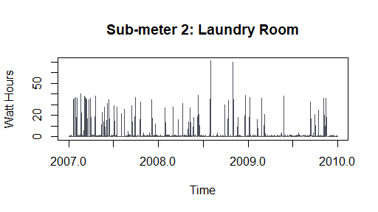
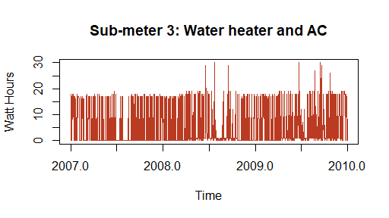

Slide 13
SUB-METERS # 1, 2, 3 LINEAR REGRESSION FORECAST VISUALIZATIONS
Two types of linear regression models were built for all three sub-metering devices
First, based on daily observations and the second based on weekly observations, both of them covering the period 2007 - 2009
Model based on weekly observations presented slightly better accuracy, however in general, level of accuracy is not statistically significant
Trend forecast for each time series model has been visualized as follows:

Slide 14
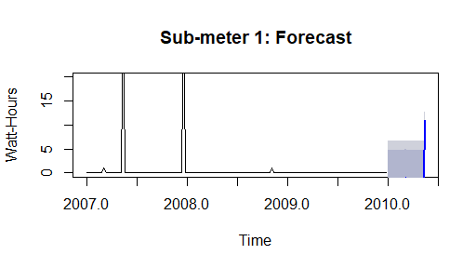
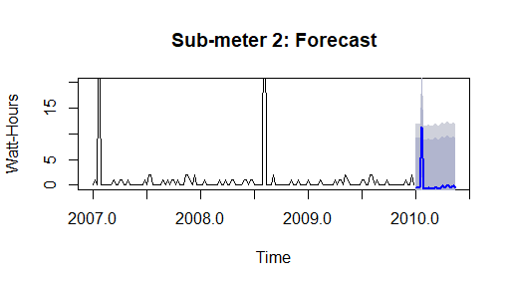
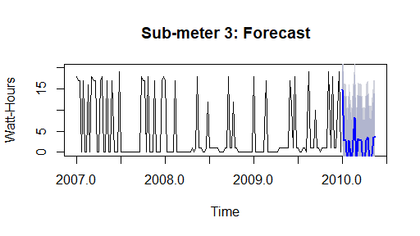

Slide 15
ACCURACY OF THE LINEAR REGRESSION MODELS SUB-METERS # 1, 2, 3
 | Sub-meter 1 | Sub-meter 2 | Sub-meter 3
R2 | 0.3442 | 0.3342 | 0.369
RMSE | 4.148 | 6.354 | 6.899

Slide 16
DECOMPOSITION VISUALIZATIONS
Analyzing the trend of a time series independently of the seasonal patterns
Time series were separated into three components: trend, seasonal and irregular
All of the sub-meters measurements presents seasonal components
Three different objects for each sub-meter has been created as follows:

Slide 17
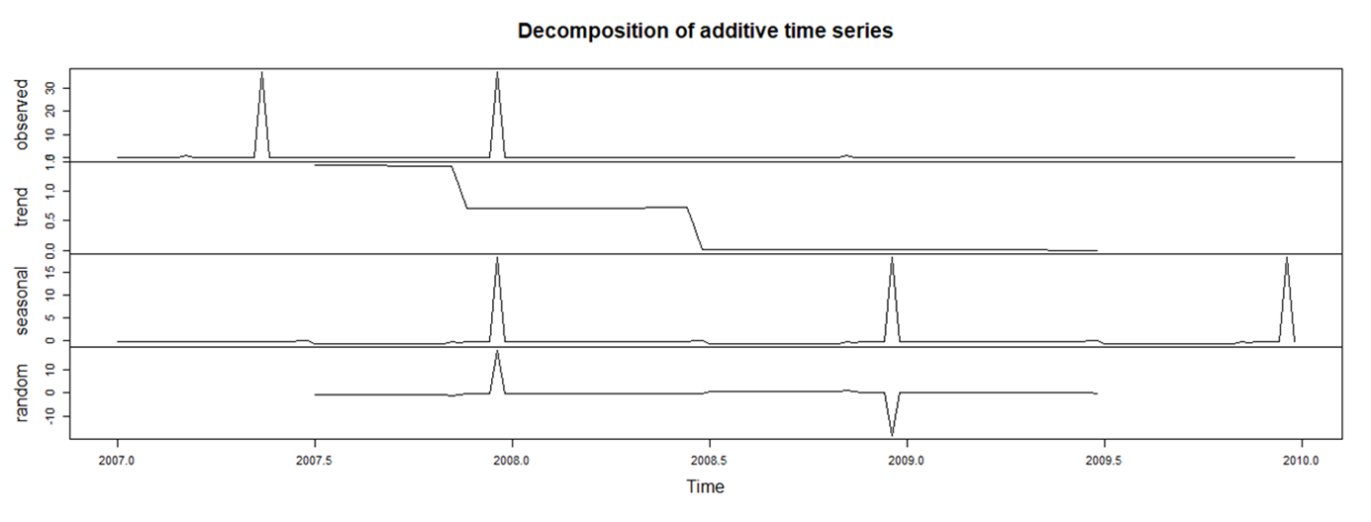
SUB-METER 1: DECOMPOSITION VISUALISATION

Slide 18
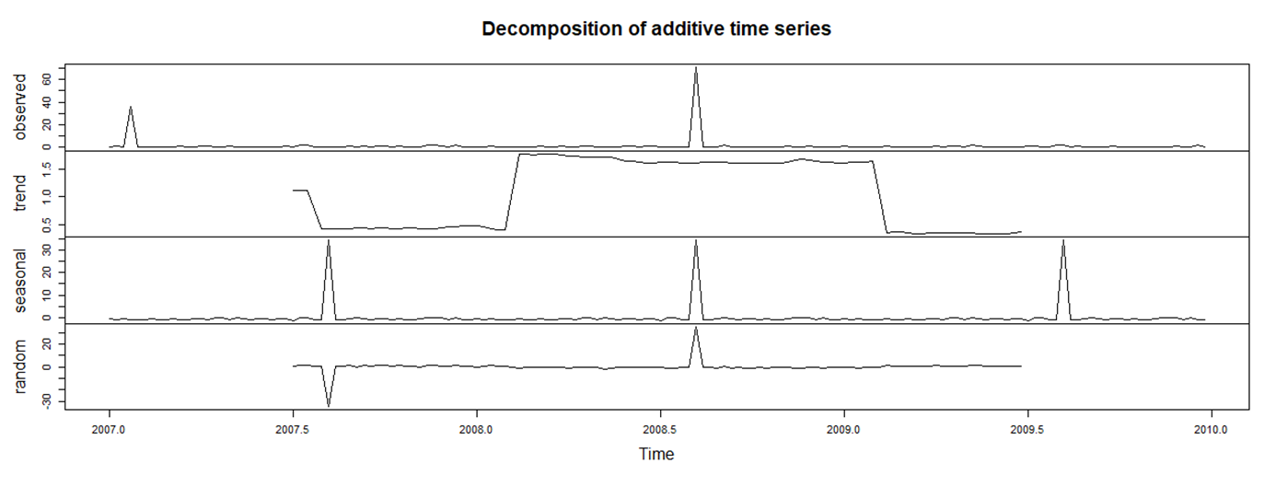
SUB-METER 2: DECOMPOSITION VISUALISATION

Slide 19
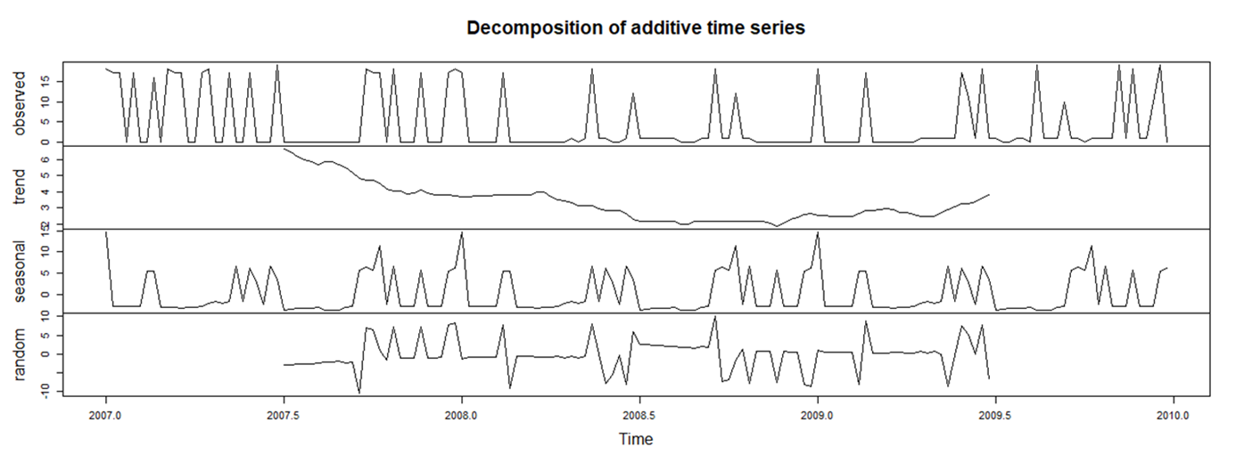
SUB-METER 3: DECOMPOSITION VISUALISATION

Slide 20
HOLTWINTERS SIMPLE EXPONENTIAL SMOOTHING
Seasonal component was removed (seasonal adjustment)
The results of the prediction show very consistent forecast for all sub-meters
Plots depicting the forecasted area are presented as follows:

Slide 21
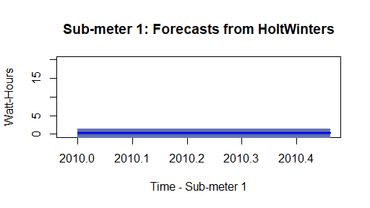
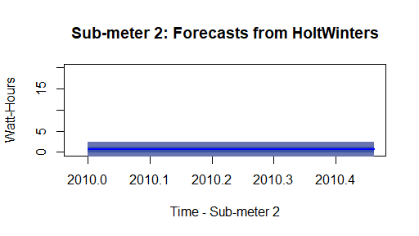
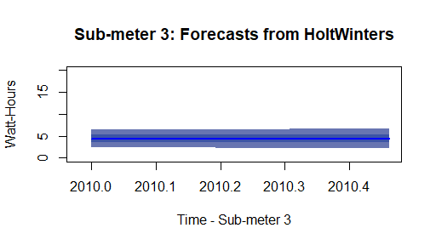

Slide 22
CONCLUSIONS
The goal of the project was partially achieved
The analysis disclosed detailed the overall picture of the power consumption within three years, based on daily, weekly and annual observations
The results of the prediction – linear regression models – presented low accuracy, current analysis doesn’t indicate statistically significant correlations
HoltWinters forecasts seem to be more exact and conservative approach than linear regression models

Slide 23
RECOMMENDATIONS
Future analysis requires improvements in data collection
Data measured by sub-meter # 3 should be further divided into two categories: water heater and AC, as 75 % of the total power usage is measured by sub-meter # 3
Customer friendly analysis could be delivered to households with additional tips regarding energy and money savings
Considering and exploring new, technologically advanced solutions of data collection as well as power management
Further analysis in order to create energy model of buildings may be considered

Slide 24
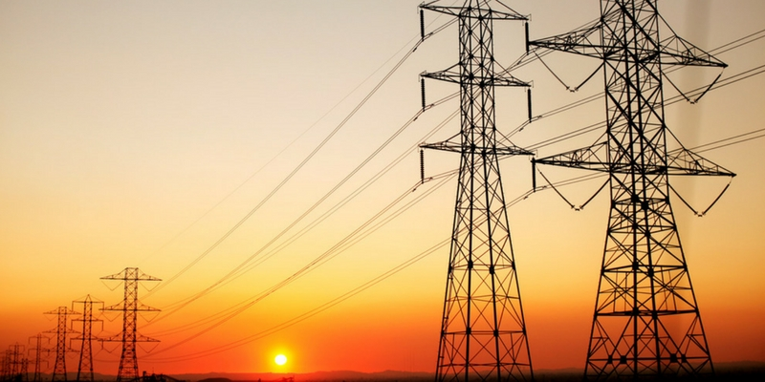
IOT Analytics

Slide 25
LESSONS LEARNED
Complex approach to the project – from importing the dataset to data manipulation, forecasting and reaching the final conclusions
Useful data manipulation techniques with dplyr
Concept of time series learned through practice
Overcoming minor and major problems with Rstudio
Ability to handle unknown subject matter
Next opportunity to practice forecasting
Presentation as an important tool for communicating results
Clear plan of action keeping the right balance between challenge and learning
Always turn off the lights when leaving the room

